Slide 1
Tritiated Methane as an Internal Calibration Source in Dark Matter Detectors
Richard Knoche
Candidacy Talk, May 16th 2013

Slide 2
Overview
Introduction to Dark Matter
Direct Detection of WIMPs
The Large Underground Xenon Detector (LUX)
Internal Calibration Source
Gas Phase Experiments
Liquid Phase Experiments
Simulations for LUX

Slide 3
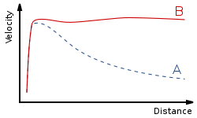
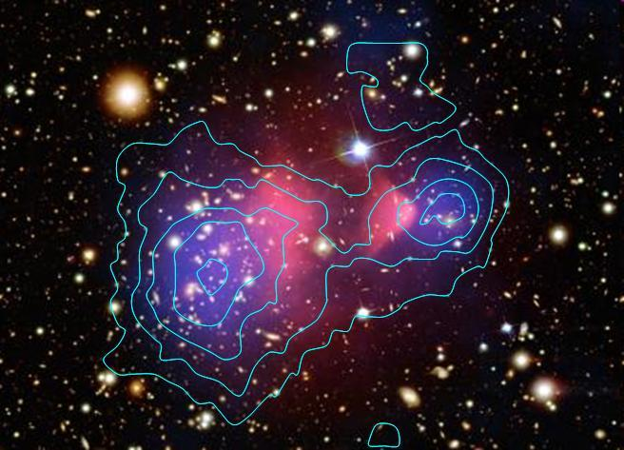
Evidence of Dark Matter
Rotational velocities of
galaxies inconsistent with
Newtonian gravity
Gravitational lensing of
cosmological objects, such as the Bullet Cluster

Slide 4

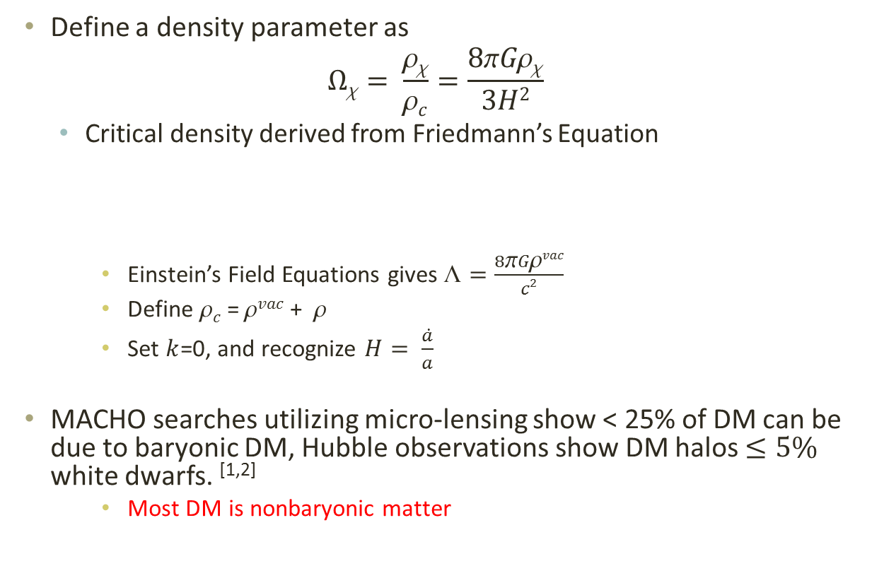
Composition of the Universe
Define a density parameter as
$$Ωχ= \frac{ρχ}{ρc}=\frac{8πGρχ}{3H2}$$
Critical density derived from Friedmann’s Equation
Einstein’s Field Equations gives $☹=\frac{8πGρvac}{c2}$
Define $c$ = $vac$ + $$
Set $k$=0, and recognize $H= \frac{\dot{a}}{a}$
MACHO searches utilizing micro-lensing show < 25% of DM can be due to baryonic DM, Hubble observations show DM halos $≤5\%$ white dwarfs. ^{[1,2]}
Most DM is nonbaryonic matter
[1] EROS Collab. Astron. Astrophys. 400:951 (2003)
[2] Alock, et al. (MACHO Collab.) Ap. J. 542:281 (2000)

Slide 5
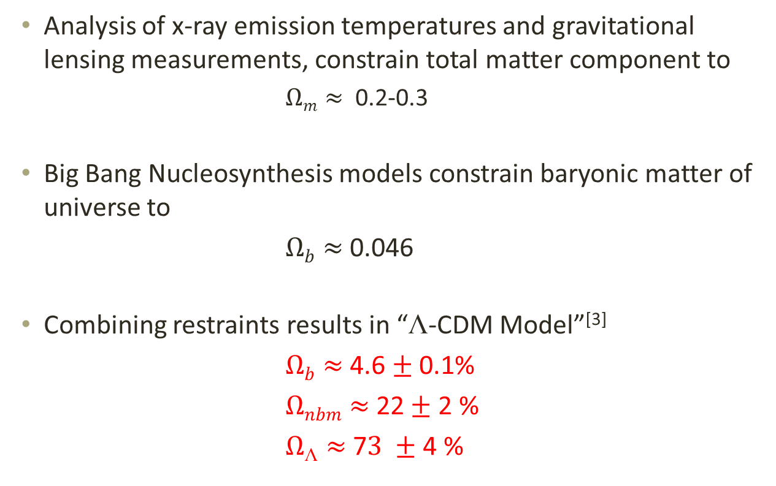
☹-CDM Model
Analysis of x-ray emission temperatures and gravitational lensing measurements, constrain total matter component to
$Ωm≈$ 0.2-0.3
Big Bang Nucleosynthesis models constrain baryonic matter of universe to
$Ωb≈$ 0.046
Combining restraints results in “☹-CDM Model”^{[3]}
$Ωb≈$ 4.6 $±$ 0.1%
$Ωnbm≈$ 22$±$ 2 %
$Ω☹≈$ 7$3 ±$ 4 %
[3] Spergel, et al. Ap. J. Suppl. 148:175 (2003)

Slide 6
Dark Matter Candidates
Axions and Axinos
Gravitons and Gravitinos
Neutrinos
WIMPs

Slide 7
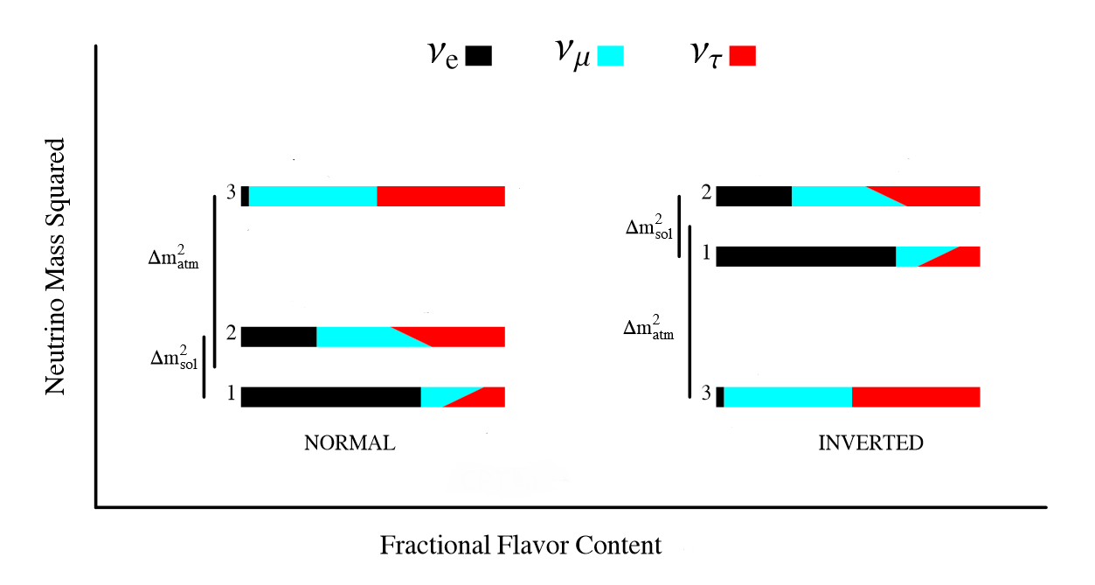

Neutrinos
Electrically neutral, weakly interacting particle with low mass
“Hot” Dark Matter
Three flavor states, composed of superposition of three mass states
m² = (7.66 $±$ 0.35) x 10⁻⁵ eV² for solar neutrino doublet
m² = $±$(2.38 $±$ 0.27) x 10⁻³ eV² Remaining mass difference^{[4]}
[4] Robertson. J. Phys.:Conf. Ser. 173:012016 (2009)

Slide 8
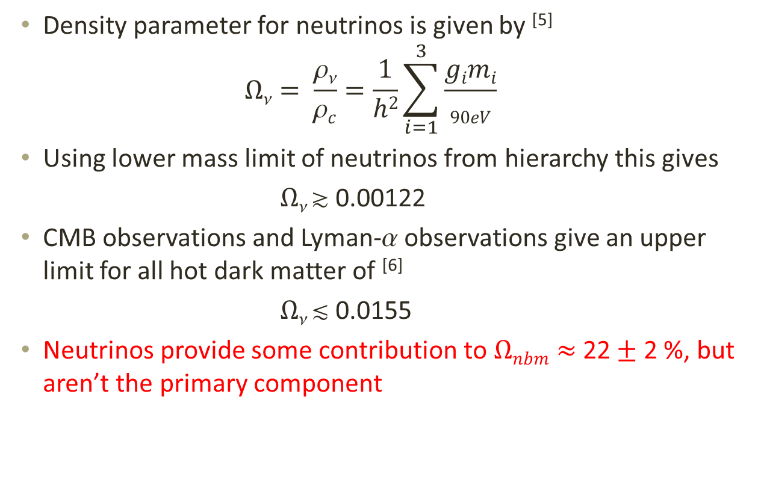
Neutrinos
Density parameter for neutrinos is given by ^{[5]}
$$Ων= \frac{ρν}{ρc}=\frac{1}{h2}\sum_{i=1}^{3}{\frac{gimi}{90eV}}$$
Using lower mass limit of neutrinos from hierarchy this gives
$Ω $ 0.00122
CMB observations and Lyman- observations give an upper limit for all hot dark matter of ^{[6]}
$Ω $ 0.0155
Neutrinos provide some contribution to $Ωnbm≈$ 22$±$ 2 %, but aren’t the primary component
[5] Pastor. Physics of Particles and Nuclei 42(4):628-640 (2012)
[6] Spergel, et al. Ap. J. Suppl. 148:175 (2003)

Slide 9
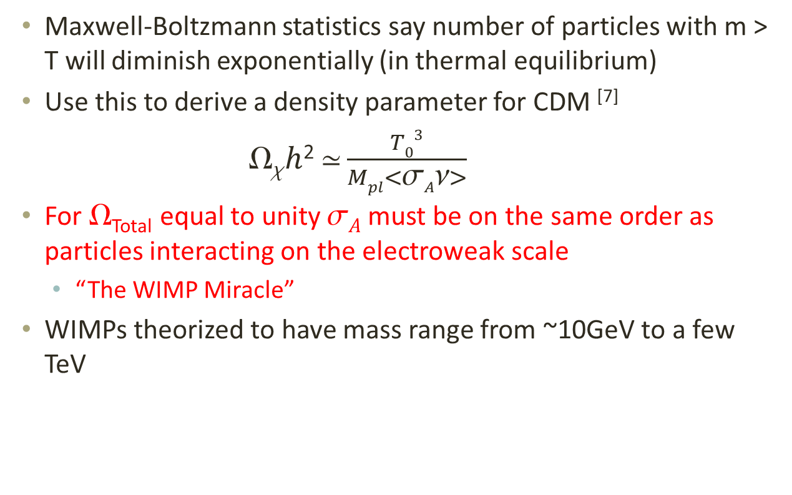
Cold Dark Matter
Maxwell-Boltzmann statistics say number of particles with m > T will diminish exponentially (in thermal equilibrium)
Use this to derive a density parameter for CDM ^{[7]}
$h$²$ \frac{T03}{Mpl<σAν>}$
For _{Total} equal to unity $A$ must be on the same order as particles interacting on the electroweak scale
“The WIMP Miracle”
WIMPs theorized to have mass range from ~10GeV to a few TeV
[7] Jungman, Kamionkowski, Griest. Phys. Rep. 267:195 (1996)

Slide 10
WIMPs and SUSY
SUSY requires supersymmetric partner particles exist for each standard model particle
Sleptons, squarks, gauginos, higgsinos
Haven’t been discovered, thought to be very massive
Neutral gauginos and neutral higgsinos are theorized to mix into a superposition called the neutralino
Lightest supersymmetric particle (LSP)
LSP is stable in models which conserve R-parity
Possible candidate for dark matter
Predicted cross section of 0.192 <  < 0.263 (Dependent on SUSY parameter space) ^{[8]}
[8] Bennet, et al. Ap. J. Suppl. 148:1 (2003)

Slide 11





Direct Detection of WIMPs
WIMPs interact via nuclear recoils in terrestrial detectors
Expect energy recoil spectrum given by ^{[9]}
Cross section has spin-independent (SI) and spin-dependent (SD) components ^{[10]}
[9] Lewin, Smith. Astopart. Phys. 6:87 (1996)
[10] Shan. JCAP 1107:005 (2011)

Slide 12
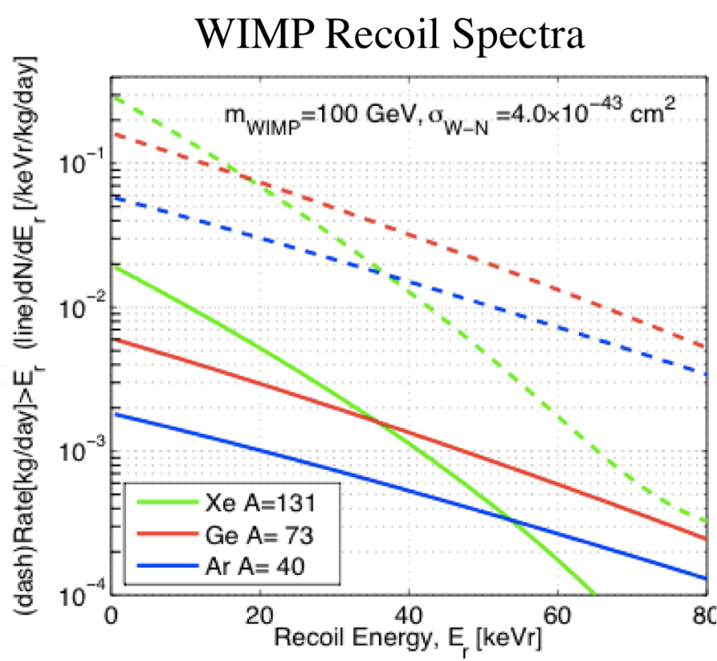
Direct Detection of WIMPs
Lighter target nuclei produce lower event rates due to A² dependence of cross section
Heavier nuclei have a sharper recoil energy spectrum due to form factor suppression
Other events include:
Electron recoils
Gamma rays and X-rays
Nuclear recoils
WIMPs and neutrons

Slide 13
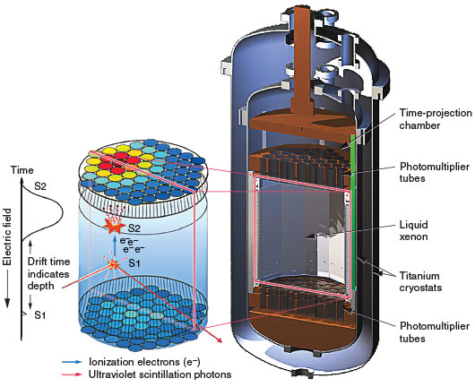
The LUX Detector
Dual phase time projection chamber
350 kg of xenon
PMT arrays in liquid and gas
Scintillation (S1) and
ionization (S2) signals

Slide 14
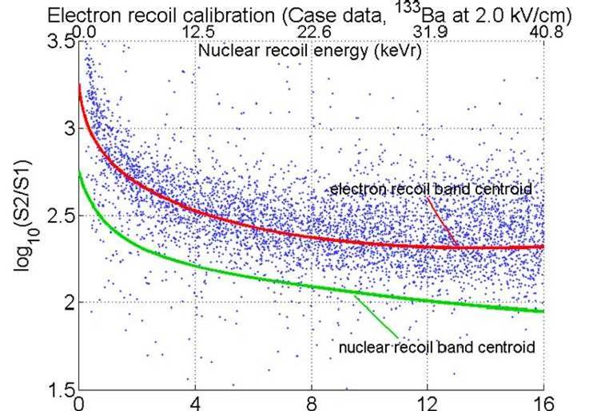
Calibration of the Detector
Nuclear recoils have higher ionization density,
leads to higher recombination probability, and higher S1/S2 ratio
Neutron source is used to generate nuclear recoil band
Beta or gamma emitter is used to generate electron recoil band
Typically external Cs-137 source
Xenon in LUX is self-shielding
External sources do not
penetrate far enough

Slide 15
Internal Calibration Source
Single beta emitter in energy range of interest (<15 keV)
Low electronegativity so that drift length is unaffected
Can not attenuate UV scintillation
Can dissolve into liquid xenon
Long enough life time to diffuse throughout detector
Must be removable after use
Short enough life time to decay away
Alternatively, something that can be removed through purification

Slide 16
Tritium as an Internal Source
Beta emitter with Q-value of 18.6 keV
Broad spectrum over entire energy range of interest
12.3 year half life
Will diffuse through detector
Must be purified away
Sticks to most surfaces
Teflon, polyethylene, steel, etc.

Slide 17
Tritiated Methane
Methane is inert due to fully saturated carbon-hydrogen bonds.
Diffusion constant in polyethylene that is 10 times smaller than hydrogen
Low electronegativity
Use tritiated methane (CH₃T) as an internal calibration source!

Slide 18
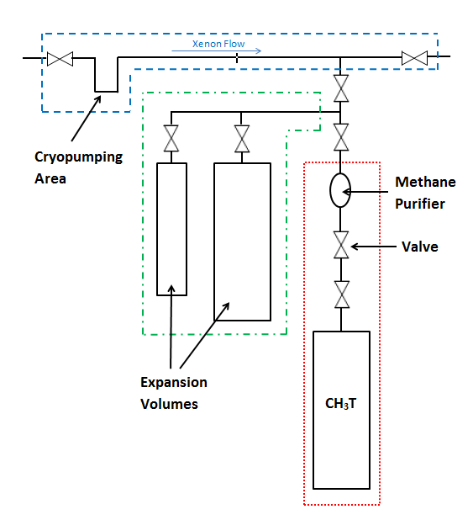
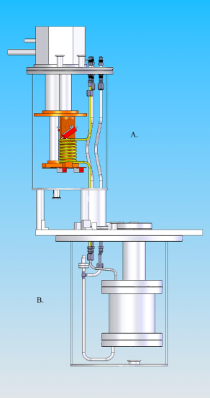
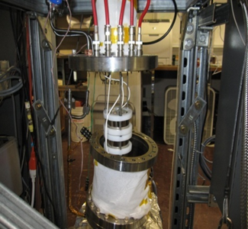
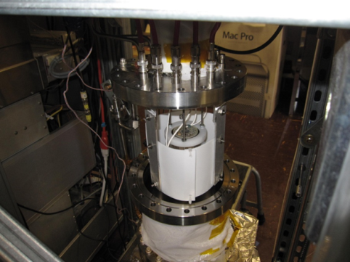
R&D Experiment – Goals and Setup
Goal of determining purification efficiency and residual contamination effects

Slide 19
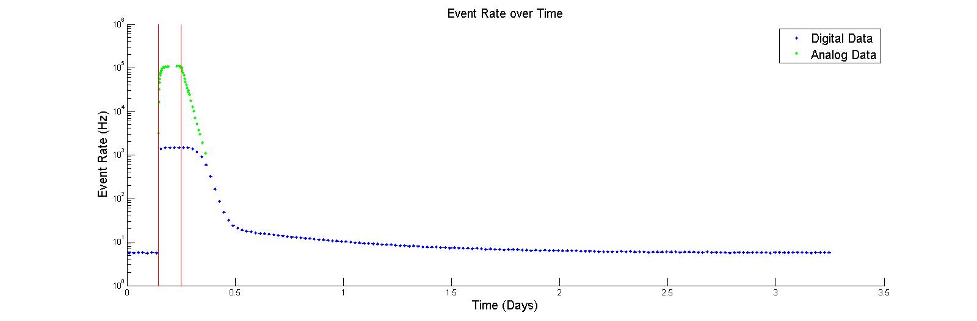
R&D Experiment- Experimental Procedure
Collect background data, inject, purify
Background Data
Injection
Purification

Slide 20
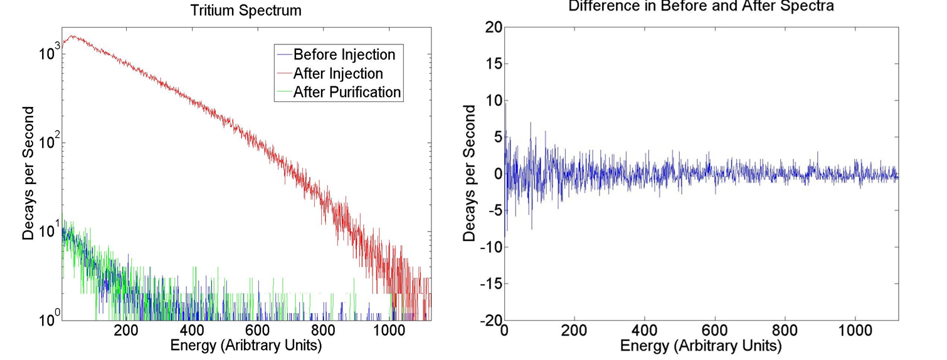
R&D Experiment- Results

Slide 21
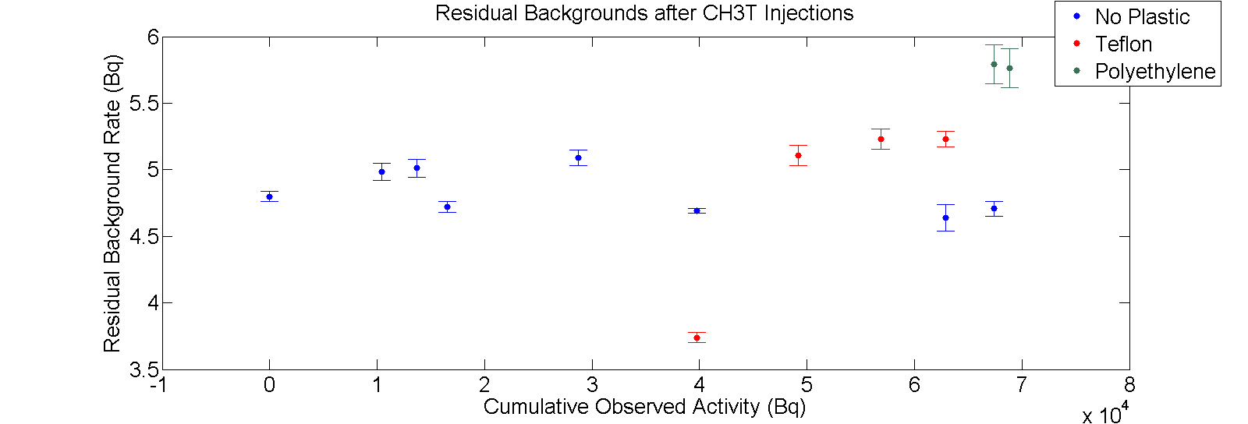

R&D Experiment- Results
Injected over 68,000 Bq with no rise in residual background rate
Jump in rate in polyethylene data is from gain change
RMS analysis gives systematic error of $±$ 0.38 Bq

Slide 22
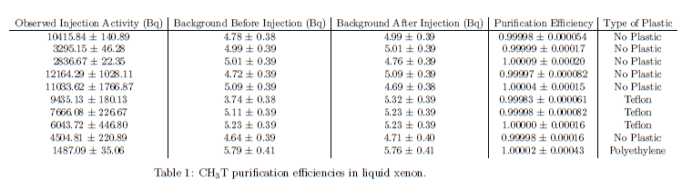

R&D Experiment- Results
Define purification efficiency
$$Purification Efficiency=1−\frac{A −B}{I−B}$$

Slide 23
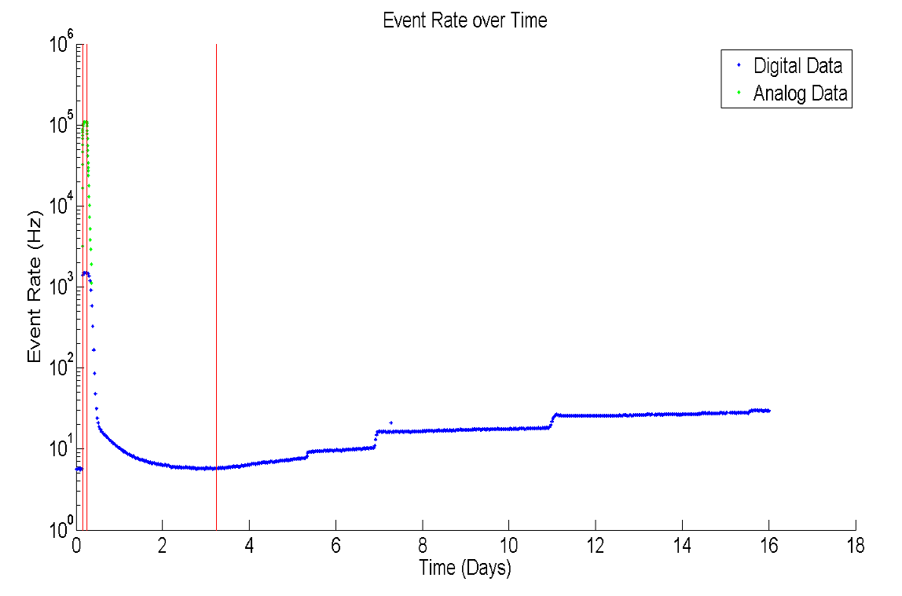
R&D Experiment- Results
Bypass the purifier to study outgassing rate
See two features – steps and gradual rise
Background Data
Injection
Purification
Bypassing Purifier

Slide 24
Conditions for a Successful Calibration
Need enough calibration events to accurately measure tritium spectrum
Define “enough calibration events” as a factor of 100 over number of background events in 300 days
Sets a goal of about 17,000 events from calibration
Calibration can not significantly add to the background rate after being purified
Define tolerable contribution to the background rate as 5% increase
Sets limit on residual activity from calibration at 0.33 Bq

Slide 25
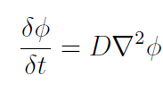


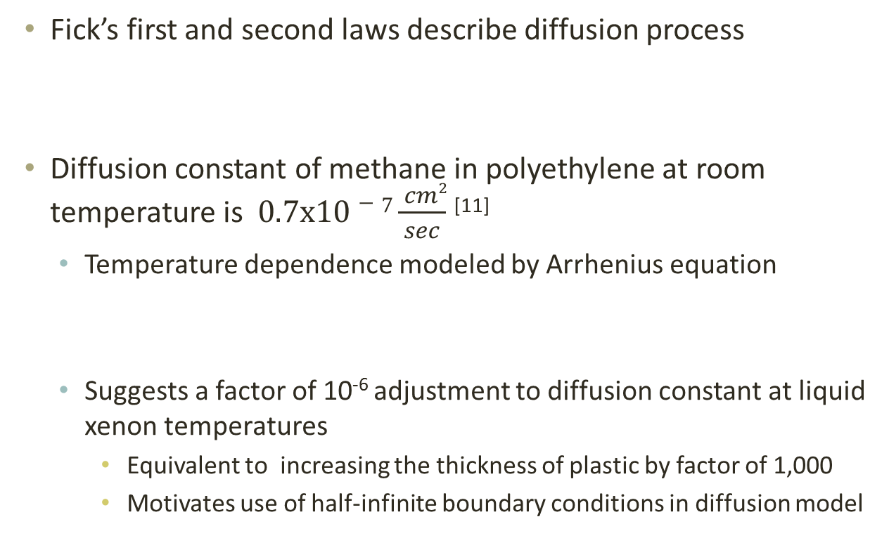
Physics of Out Gassing
Fick’s first and second laws describe diffusion process
Diffusion constant of methane in polyethylene at room temperature is $0.7x10−7\frac{ cm2}{sec}$ ^{[11]}
Temperature dependence modeled by Arrhenius equation
Suggests a factor of 10⁻⁶ adjustment to diffusion constant at liquid xenon temperatures
Equivalent to increasing the thickness of plastic by factor of 1,000
Motivates use of half-infinite boundary conditions in diffusion model
[11] Miyake, et al. J. vac. Sci. technol. A. 1:1446-1451 (1983)

Slide 26
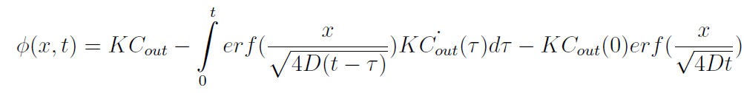
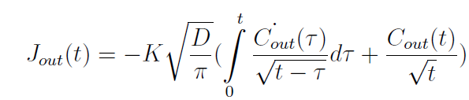

Physics of Out Gassing
Analytic solution to Fick’s second law using half-infinite boundary conditions ^{[12]}
Plug into Fick’s first law, evaluate at x=0 for out gassing
Define new constant
[12] Piche. Partial Differential Equations. Tampere Uni. of Tech.

Slide 27
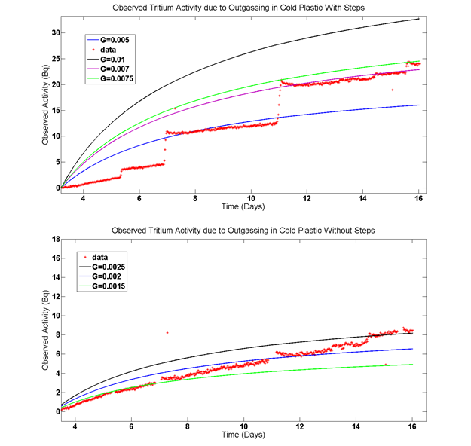
Fitting our Data
Fit to outgassing
data to determine G
0.001 < G < 0.01

Slide 28

Numerical Simulations of CH₃T Activity in LUX
Use constraints on G to numerically model CH₃T rate in LUX after a calibration
Use Fick’s laws to get flux from out gassing (J)
Use time dependent concentration that includes out gassing and purification

Slide 29
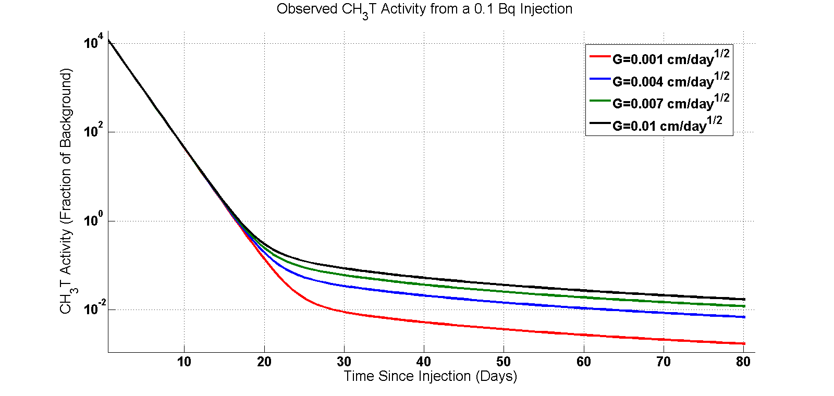
Simulated Activity in LUX after a CH₃T Calibration
0.1 Bq injection gives ~15,000 events and reaches 5% of background in less than 40 days for all G values
5%

Slide 30
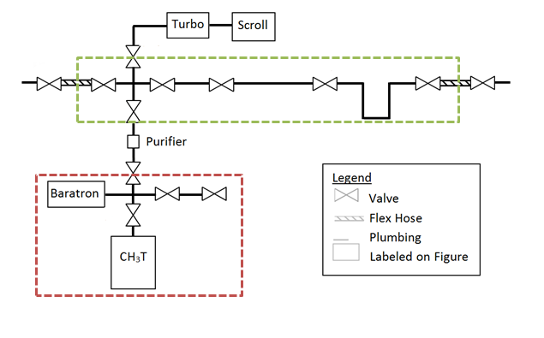
Tritium Injection System for LUX
Range on injection activities from 0.00625 Bq to 0.4 Bq
No cryopumping required
Flow Through Expansion Volumes
35 Bq Tritiated Methane Source

Slide 31
Future Studies
Need to verify purification time constant in LUX
Time constant effects numerical simulation results due to its effect on the exponential term
Use natural methane injection to accurately measure 
Need to verify solubility in LUX
Our numerical simulations assume perfect mixing in LUX
Start with an absolute injection of 0.1 Bq, scale injection as needed

Slide 32
Conclusion
It is possible to use tritiated methane as an internal calibration source in xenon detectors
Hot zirconium getter can remove 100% of injected activity (within error)
Care must be taken to model outgassing and purification effects on injection activity
To meet LUX’s goal of ~17,000 calibration events with a return to 5% of initial background a 0.1 Bq injection is required

Slide 33
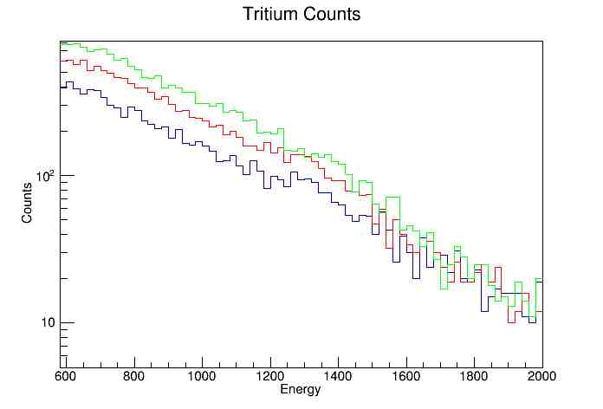

Additional Slides – Step Spectra
Closer look at the steps – are they really tritium?
8833 $±93.98$events -> 13156 $±$ 114.70 events -> 17190 $±$131.11 events

Slide 34
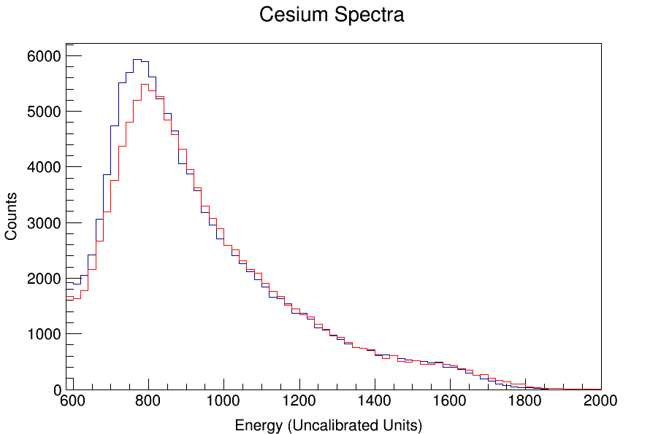
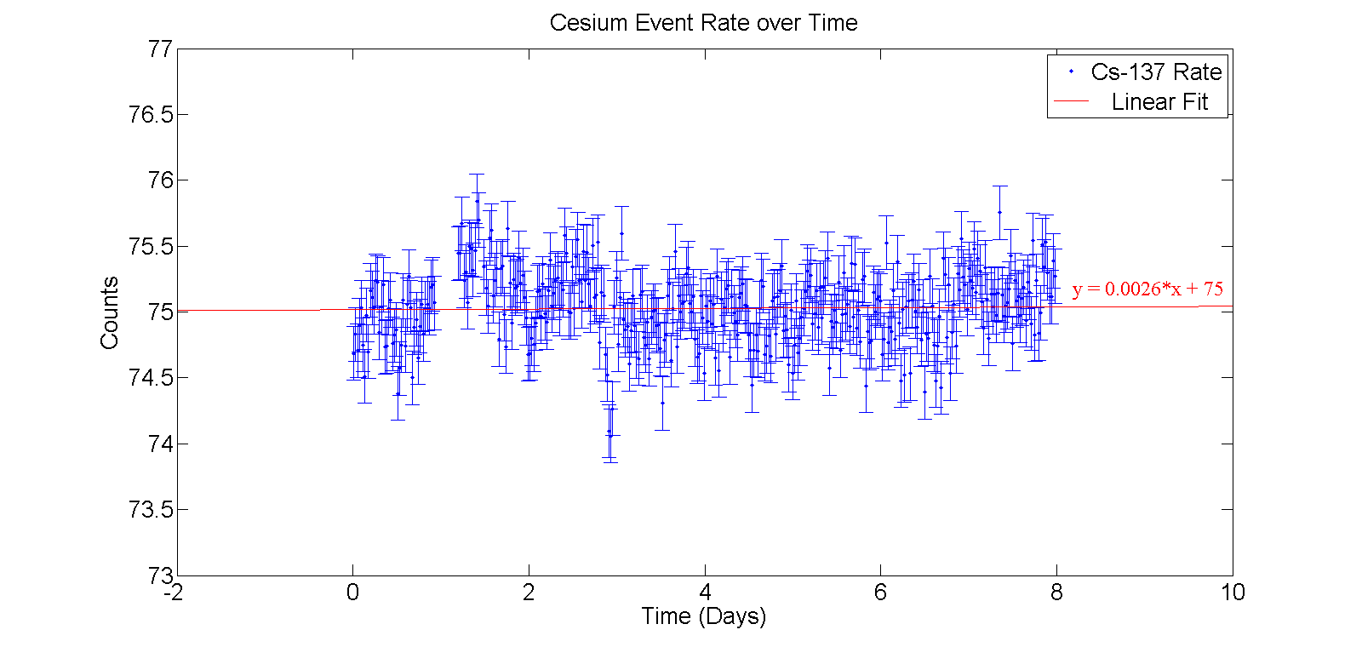
Additional Slide – Cs-137 Data
Two possible explanations
Gain is drifting (shifts spectrum horizontally)
More tritium is showing up (shifts spectrum vertically)
Use cesium-137 peak to search for changes in gain
No change in gain Must be from pockets of tritium

